Slide 1
Dockerized Test Automation Framework

Slide 2
Dockerized Test Automation Framework
Dockerized Parallel Test Automation Framework with Allure Reporting
Project Overview
Project Purpose & Goals
Project Scope
Software Architecture
Architecture Overview
Technical Implementation Overview
Dockerfile Configuration
Docker Compose Configuration
Test Suite Implementation

Slide 3
Dockerized Test Automation Framework
Allure Reporting
Conclusion and Recommendations

Slide 4
Dockerized Parallel Test Automation Framework with Allure Reporting
Project Title: Dockerized Parallel Test Automation Framework with Allure Reporting emphasizes streamlined test execution efficiency.
Presentation Overview: Outline key aspects of implementation, automation benefits, and reporting enhancements throughout the framework.
Significance: Explains the importance of continuous testing in modern software development for quality assurance efforts.

Slide 5
Project Overview
Framework Purpose: Designed to optimize testing efficiency through Docker's parallel execution, enhancing overall process speed and reliability.
Docker Utilization: Leverages containerization for isolation and scalability, allowing multiple API tests to run simultaneously without conflict.
Allure Reporting: Integrates Allure for visualizing test outcomes, providing in-depth analytics and interactive reports for easier failure diagnosis.

Slide 6
Project Purpose & Goals
Enable Parallel Execution: Facilitates running multiple API test suites concurrently, significantly improving overall test throughput and efficiency.
Reduce Test Execution Time: Aims to minimize total execution duration, providing quicker feedback during the development lifecycle for better agility.
Generate Detailed Reports: Employs Allure to create comprehensive and interactive reports, enhancing visibility into test results and patterns.

Slide 7
Project Scope
Docker Environment Setup: Establishing a Dockerized configuration optimizes resource allocation and maintains isolated testing environments for APIs.
Parallel Testing with pytest-xdist: Utilizing pytest-xdist enables concurrent test execution, thereby drastically cutting execution time for large test suites.
Environment Variable Management: Managing environment variables effectively ensures flexibility and consistency across different containers during test execution.

Slide 8
Software Architecture
Modular Architecture: The architecture uses independent Docker containers for test execution, promoting scalability and separation between tests.
Centralized Reporting: Allure Reports are generated centrally, synthesizing results from all containers into a comprehensive, user-friendly format.
Scalability Benefits: Containerization allows dynamic scaling, facilitating the addition of more containers as testing requirements expand.

Slide 9
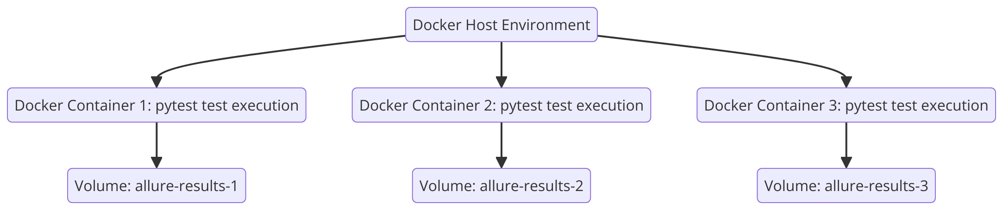
Architecture Overview
Container Orchestration: Utilizes docker-compose for orchestrating multiple containers, streamlining management and enhancing parallel execution capabilities.
Scaling Capabilities: Dynamic scaling allows seamless adjustment of test container instances according to varying load requirements during testing.
Efficient Resource Management: Optimizes resource allocation within containers, ensuring maximum utilization while maintaining isolation between concurrent tests.

Slide 10
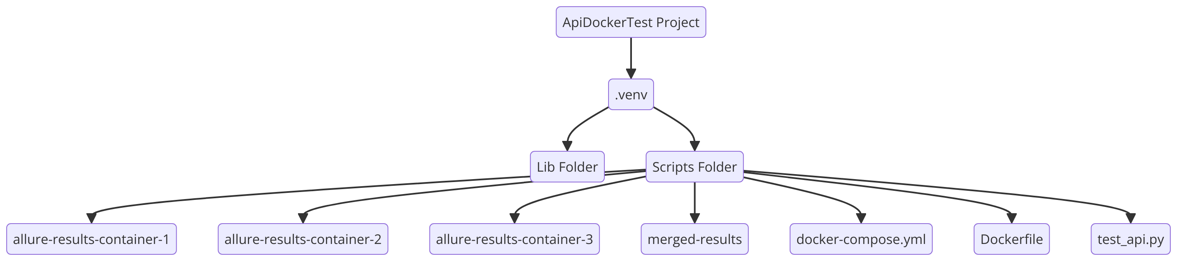
Technical Implementation Overview
Dockerfile Usage: Configures Dockerfile to set up the testing environment, ensuring necessary libraries are installed and environment variables defined.
Docker Compose Setup: Leverages Docker Compose for managing multi-container architecture, simplifying deployment and enhancing service interactions effectively.
Test Suite Configuration: Implements pytest with Allure integration, enabling structured test management and comprehensive report generation across multiple containers.

Slide 11
Dockerfile Configuration
Base Image Specification: Uses python:3.8-slim as the base image for a lightweight environment suitable for testing requirements.
Library Installation Commands: Includes commands to install pytest, pytest-xdist, allure-pytest, and requests ensuring all dependencies are met.
Environment Variable Configuration: Defines RESULTS_DIR environment variable for consistent storage of test results across different Docker containers.

Slide 12
Docker Compose Configuration
Service Configuration: Defines individual test services within Docker Compose to handle multiple parallel container instances efficiently.
Environment Variables Management: Specifies environment variables for each service ensuring consistent configurations across all testing containers.
Volume Mapping Strategy: Establishes mappings for persistent storage of test results, preserving data integrity across container lifecycles.

Slide 13
Test Suite Implementation
Test Suite Implementation: Utilizes pytest and allure-pytest for structured API tests, ensuring validations across specified endpoints are thorough.
API Endpoint Validation: Performs GET requests on various API endpoints, verifying status codes and logging responses for detailed reporting.
Interactive Reporting Features: Employs Allure to generate interactive reports, facilitating better visualization of test results and identifying failures.

Slide 14
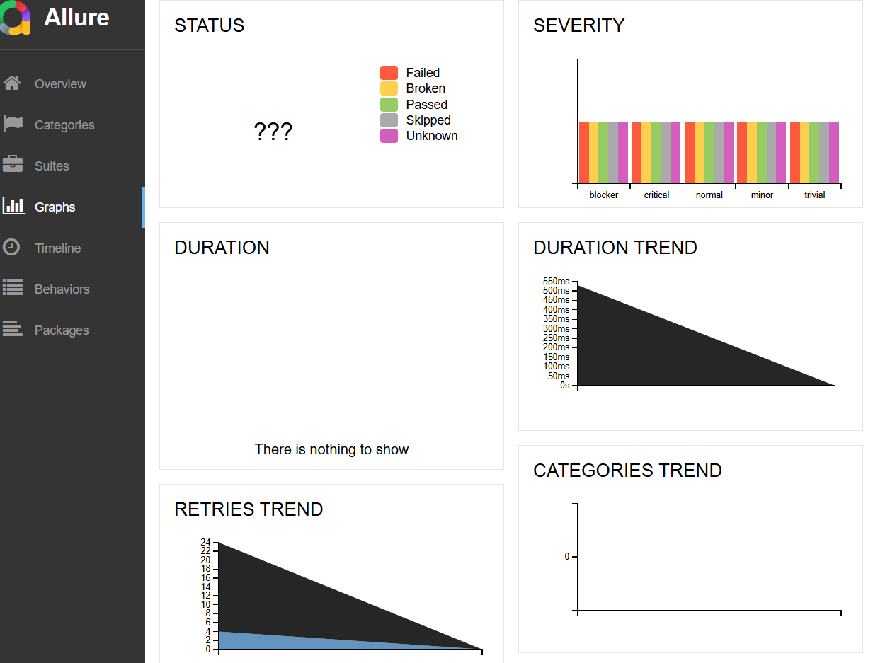
Allure Reporting
Comprehensive Report Generation: Allure consolidates results from multiple containers, providing a unified and detailed view for analysis.
Interactive Elements in Reports: Test reports include clickable features, enabling users to explore individual test cases and outcomes effortlessly.
Visual Representation of Results: Utilizes visual graphs and statistics to aid in interpreting data trends and pinpointing areas for improvement.

Slide 15
Conclusion and Recommendations
Docker Advantages: Containerization offers reproducible environments, ensuring consistent testing across different stages and platforms effectively.
Allure Benefits: Integrating Allure enhances test report interactivity, allowing for detailed failure analysis and improved stakeholder communication.
CI/CD Integration: Suggest integrating CI/CD pipelines for continuous testing, automating execution and reporting within development workflows systematically.

